Slide 1

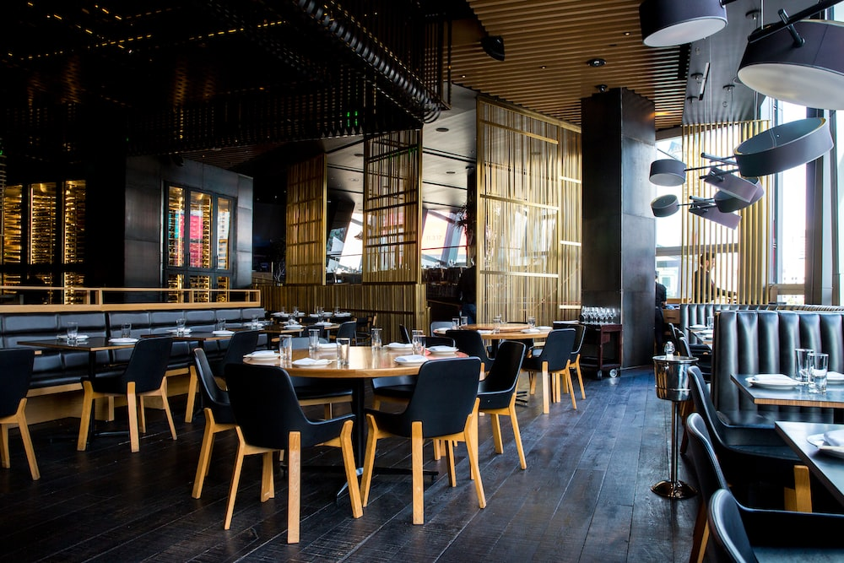

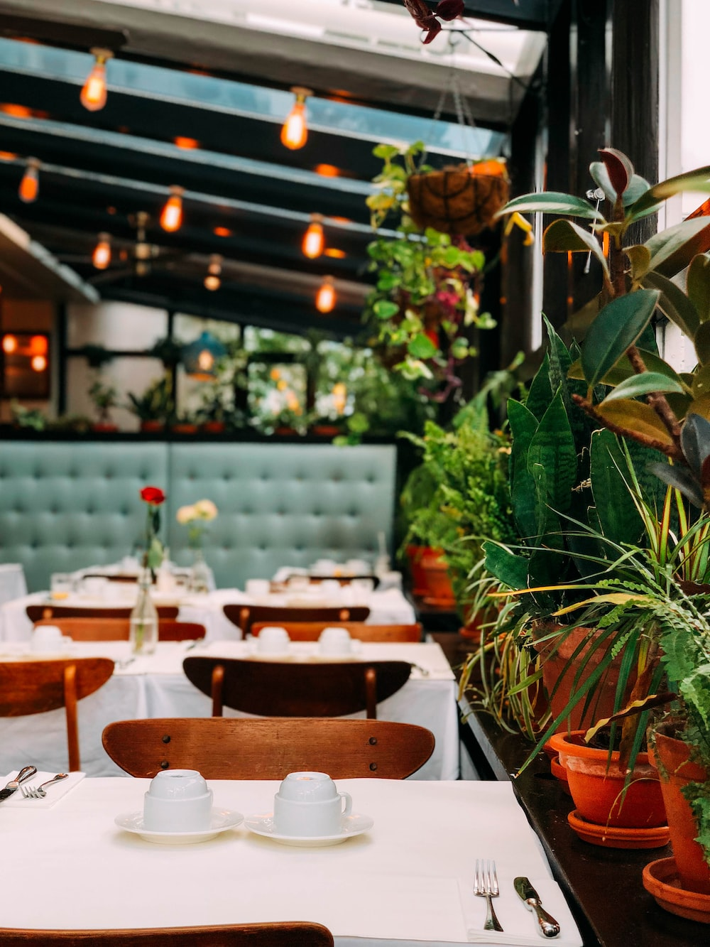
LEVERAGING MACHINE LEARNING AND SOCIOECONOMIC INDICATORS TO RECOMMEND A BEST LOCALITY FOR RESTAURANT IN INDORE
SUBMITTED BY:
Taruna Sahu
M.Tech IV SEM

Slide 2
Outline
The Problem
Methodology
Result
Conclusion
Future Scope

Slide 3
Problem statement
In Indore, if someone is looking to open an Indian restaurant, where would you recommend that they open it?
According to a report, 60% of restaurants shut down within the first year of operations, and up to 80% of restaurants close their operations in the first five years

Slide 4

Why Do Restaurants Fail?
There are many reasons that a restaurant may fail, but here are the 6 most common reasons:
Bad Location
Inexperience
Inflated costs
Improper pricing
Lack of Marketing
Disorganization

Slide 5
A BAD LOCATION
My project aims to find the best location to open an Indian restaurant in the city of Indore, India, to maximize the profit of the owner.

Slide 6
METHODOLOGY
MODEL
DATA PREPROSSESING
DATA COLLECTION
EVOLUTION

Slide 7
DATA COLLECTION
75
Dataset containing Neighborhoods of Indore, the dataset holds the names Neighborhood in Indore extracted from Wikipedia.
Here is a link to the dataset. https://en.wikipedia.org/wiki/Category:Neighbourhoods_in_Indore
There are total 75 localities in Indore.

Slide 8
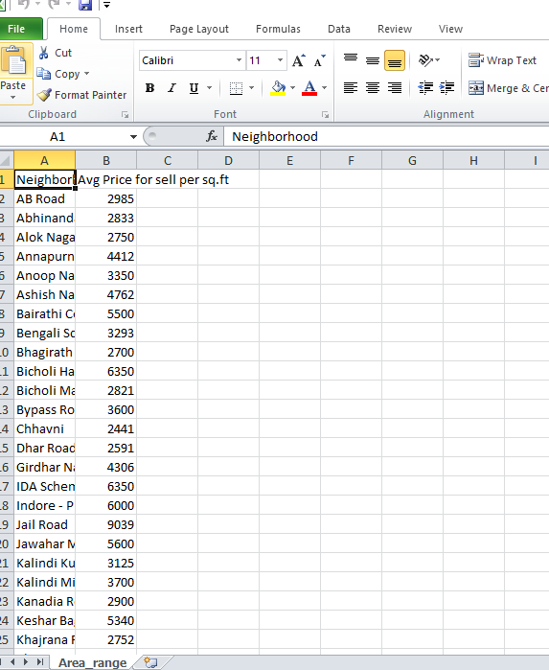
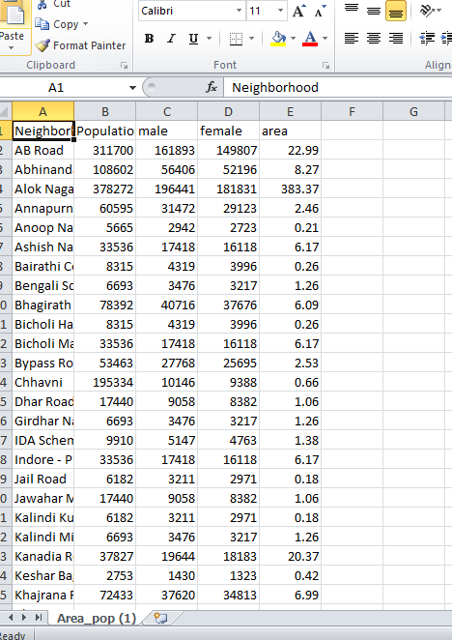
DATA COLLECTION
The Colony wise population , Selling price of land per Square feet and area of the localities in km also collected.

Slide 9
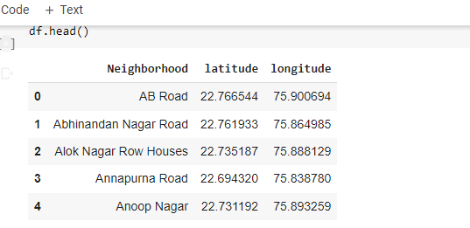
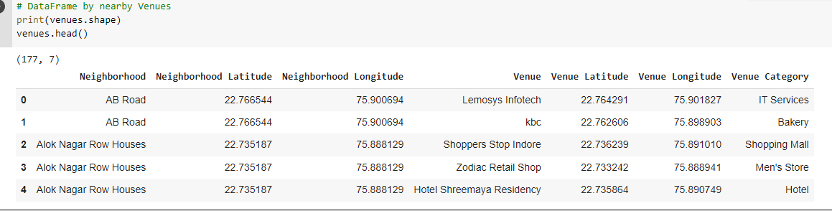
DATA COLLECTION
I Used Geopy Python Library to get Coordinates of Neighborhood.
Foresquare Api to explore near by venues, venues category and their coordinates.

Slide 10
DATA PREPROSSESING
Cleaning and formatting the data
Handling missing values and outliers
Drop Missing values
Grouped venue data based on neighborhood
Normalizing the data for consistency
Done ONE HOT Encoding for Clustering the data.

Slide 11
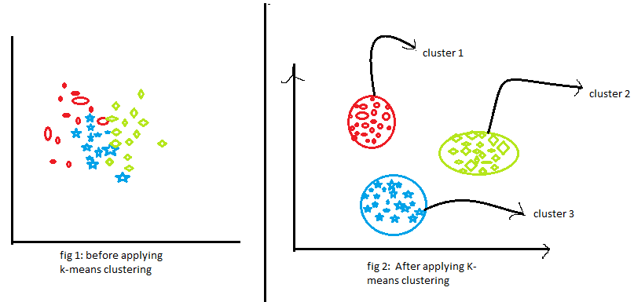
K-MEANS CLUSTERING
K-means clustering is an unsupervised machine learning algorithm used for grouping data points into K clusters based on their similarity. It does not require labeled data for training and works solely on the input features. The main features of K-Mean Clustering are as follows:
Centroid-Based Clustering
Iterative Optimization
Minimizing Within-Cluster Variance
Sensitivity to Initial Centroid Selection:

Slide 12
Evolution:
Indore has total 75 Neighbourhood.
Part 1: Clustering of Neighbourhoods.
Clustering based on Venue Category.
Clustering based on Restaurant Type.
Clustering based on Population and Area.
Part 2: Analyse the Cluster.

Slide 13
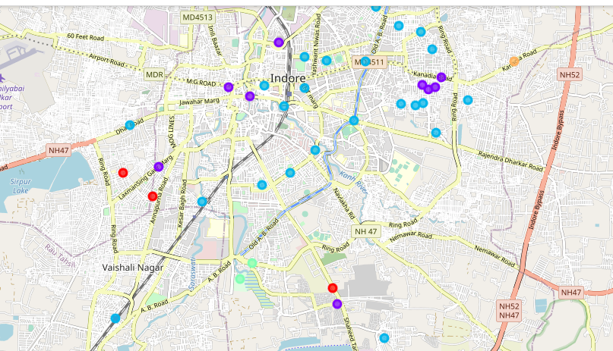
Clustering Based on Venue Category:
Total 5 Cluster are create on venue Category. After Analysing each Cluster results are as follows:
cluster 1 has the most common venue is an ATM.
cluster 2 has the most common venue snack place and hotel.
cluster 3 has the most common venue hotel and Indian restaurant.
cluster 4 has the most common venue park and bar.
cluster 5 has the most common venue as an ATM.

Slide 14
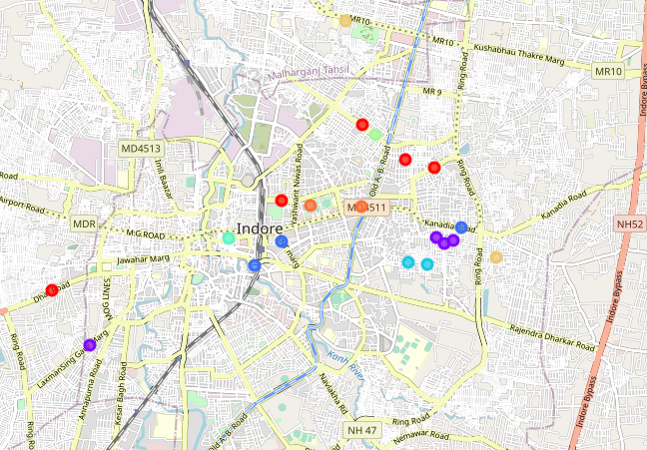
Clustering Based on Restaurant Type:
There are a total of 8 clusters created. After analyzing each cluster we get :
cluster 1 has the most common venue Fast food restaurant.
cluster 2 has the most common venue Indian restaurant.
cluster 3 has the most common venue Indian restaurant.
cluster 4 has the most common venue restaurant.
cluster 5 has the most common South Indian restaurant.
cluster 6 has the most common venue as an Asian restaurant.
cluster 7 has the most common venue restaurant.
cluster 8 has the most common venue for Indian restaurant.

Slide 15
Clustering Based on Population & Area:
There are a total of 5 clusters created. After analyzing each cluster we get :
cluster 1 has the most common venue hotel.
cluster 2 has the most common venue Bus Station.
cluster 3 has the most common venue Bus Station.
cluster 4 has the most common venue Juice Bar.
cluster 5 has the most common venue Indian and Fast Food Restaurant.

Slide 16
RESULTS:
After Analyzing the each cluster the model recommends Vijay Nager, South Tukoganj, Khajrana Road, Anoop Nager, Dhar Road, Chhavni as the best locations for opening a restaurant .

Slide 17
CONCLUSION
The project involved collecting data on various socioeconomic indicators such as population density, income levels, and restaurant density in different localities of Indore.
This data was then used to train a machine learning model, specifically a K-means clustering algorithm, to group localities based on their similarities and identify potential locations for the Indian restaurant.
The results of the project showed that the machine learning model was able to accurately identify the best locality for the Indian restaurant based on the socioeconomic indicators.
This approach can be extended to other business types and in other cities, providing valuable insights to entrepreneurs and investors looking to start or expand their businesses.

Slide 18
FUTURE SCOPE
Expanding the scope to other city
Incorporating additional data source
Developing a Web Application
Expanding the Business Types

Slide 19
Questions?

Slide 20
References

